Slide 1
Data Analysis on Bay Area Housing Market
Sreeraj Yeduru uy8958

Slide 2
WELCOME!!!
We all know how the housing market in the Bay Area is pretty unforgiving at the moment. My group and I decided to see just how unforgiving it actually is and possibly get more insight into how we can manage around it.

Slide 3

Our Choice
My group and I web scraped Zillow to pull vital information needed to perform data analysis and visualization on parts of the current market.

Slide 4
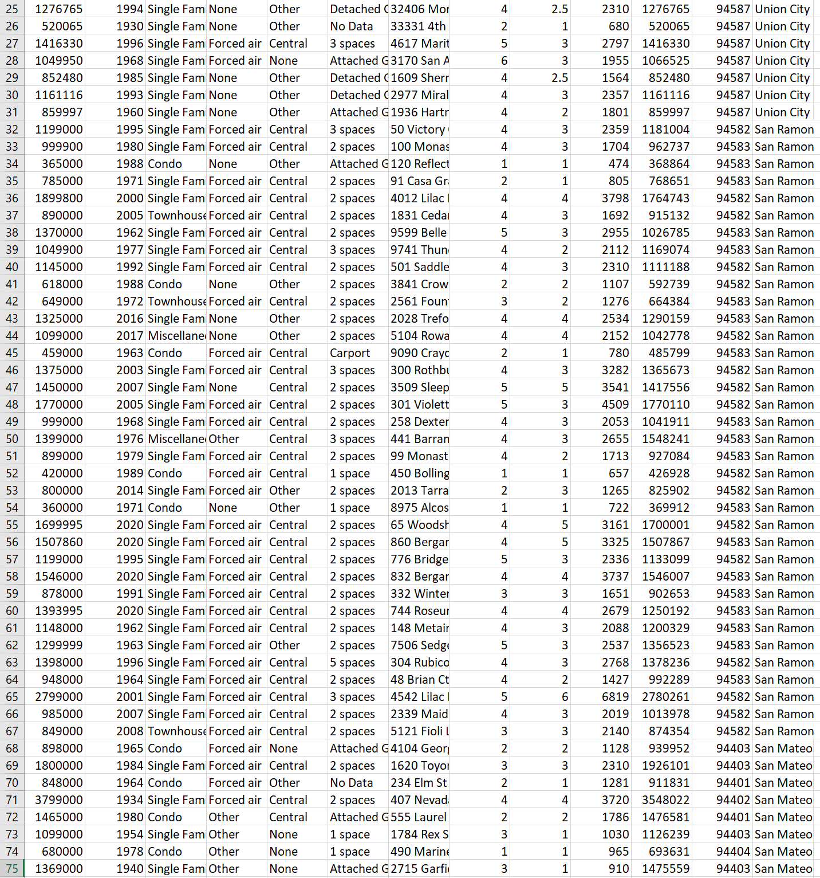
My Choice
I chose to do my analysis on the data we scraped for the locations of Union City, San Mateo and San Ramon.

Slide 5
Locations
These locations can be categorized into three different categories:
San Mateo - On the Peninsula side of the Bay. South of San Francisco and is the suburbs.
Union City - Located on the east side of the Bay and inbetween bigger cities like Fremont and Oakland. It is another suburban town and close to Silicon Valley.
San Ramon - Located in the valley and on the edge of the eastern side of the Bay Area. This small suburban town is the farthest from the water and a big city compared to the others.

Slide 6
Min, Mean and Max of Price and Zestimate per City
Method:
Slice the data to separate the Price and Zestimate data by City, create 6 (Price and Zestimate x 3 Cities) separate dataframes.
Create int values that hold the max, min and mean of the 6 data frames.
Plot

Slide 7
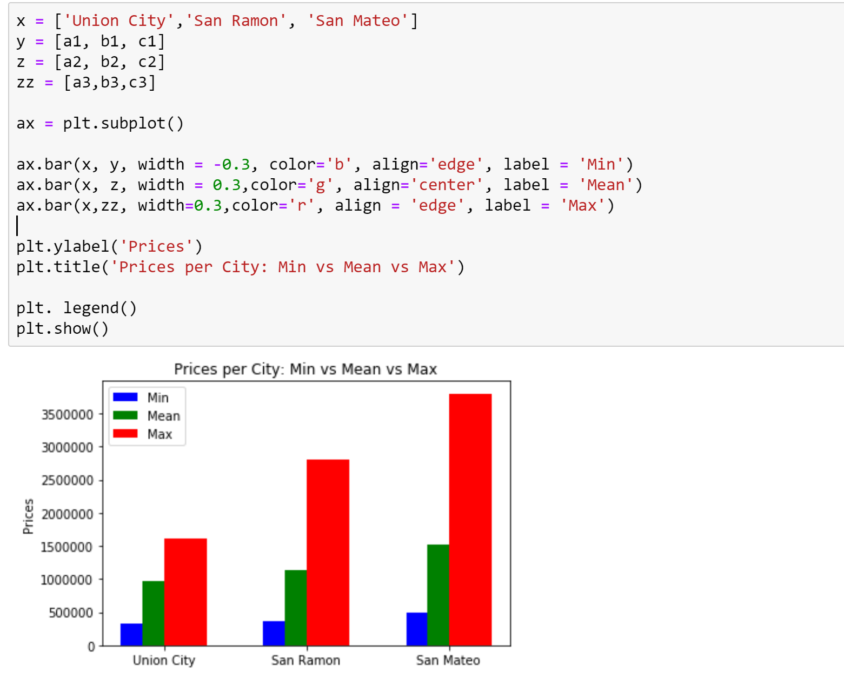
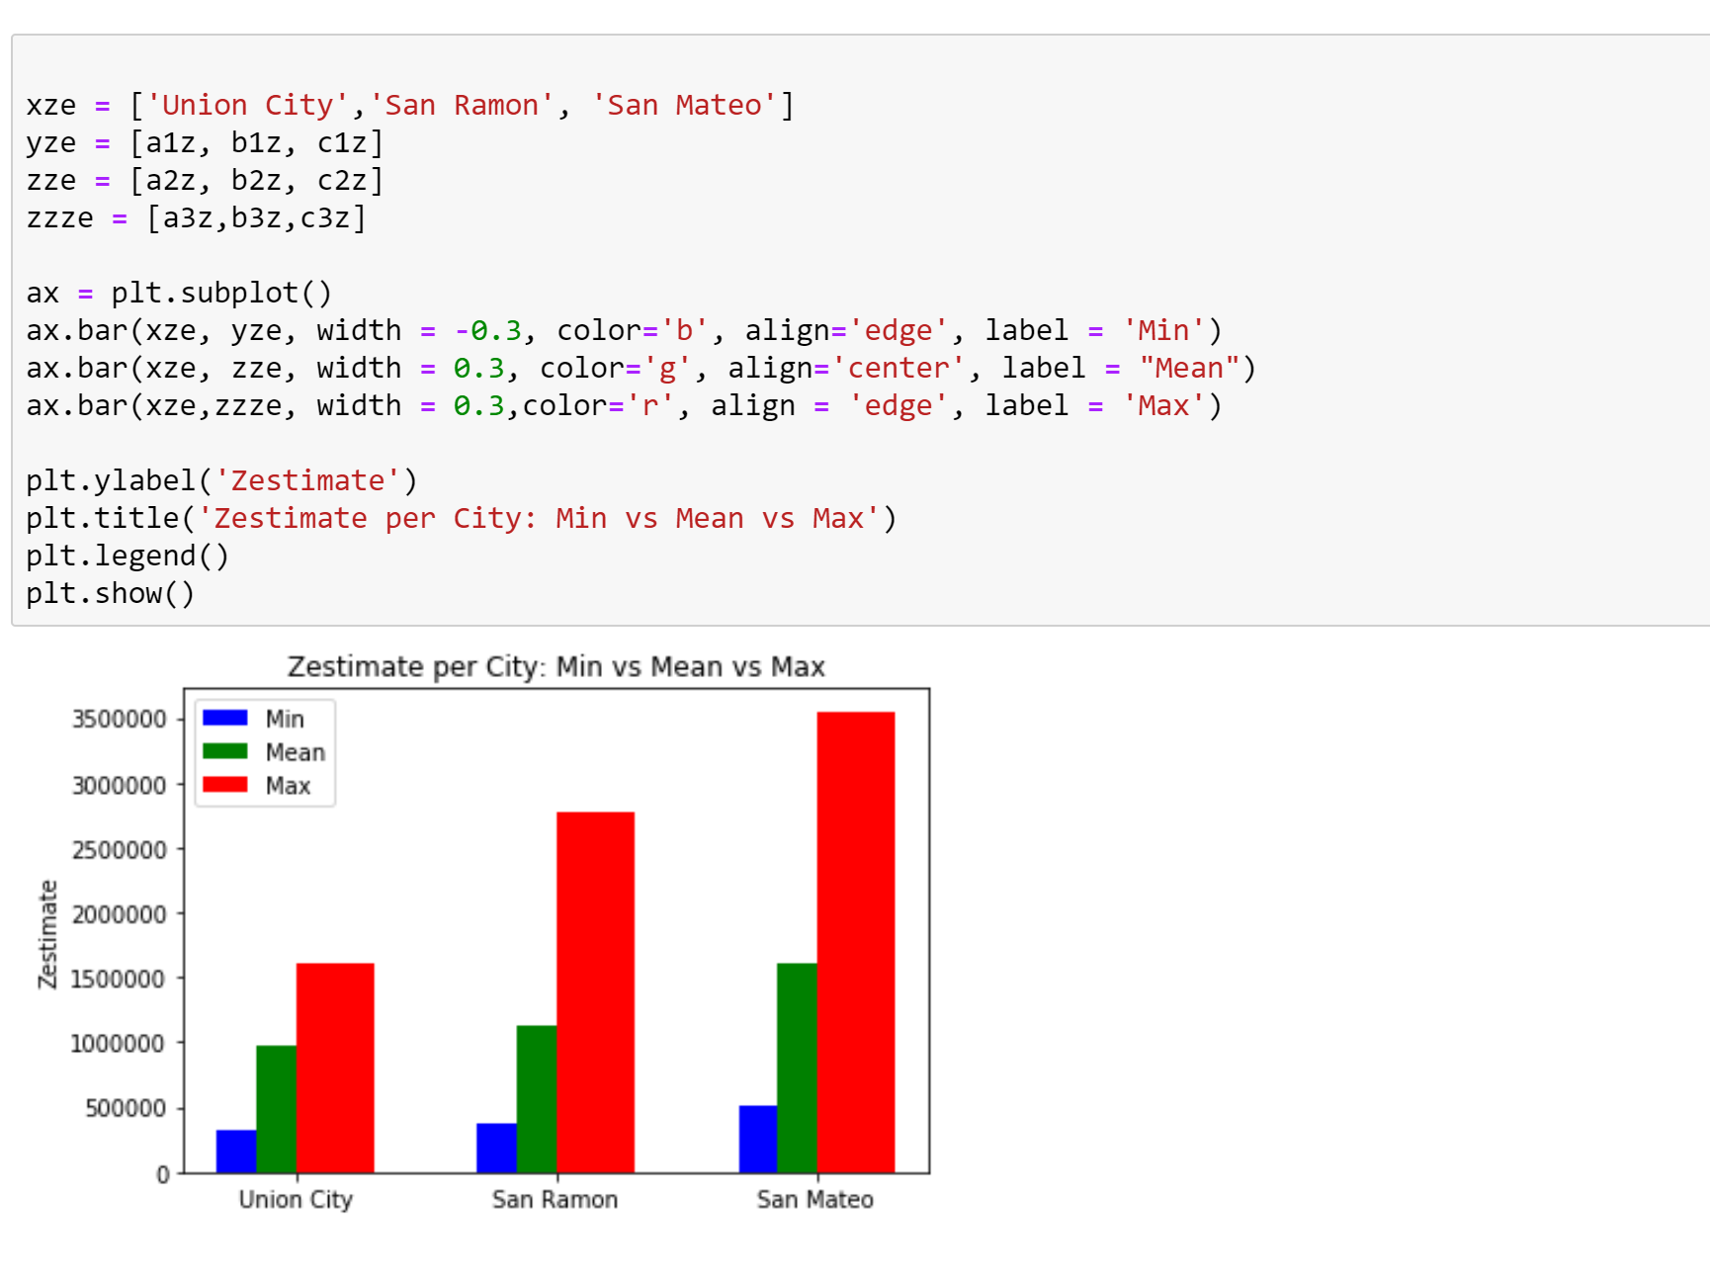

Slide 8
Analysis
We see that Union City is the cheapest city of the three and San Mateo is the most expensive. As San Mateo is on the peninsula it makes sense that it is the most expensive. Comparing mean prices between Union City, which is near less appealing cities such as Hayward and San Leandro, it is very plausible that San Ramon would be more appealing for families to settle and would more expensive. I am not surprised to see such a small difference between the two with Union City still being relatively close to Fremont and Silicon Valley and would assume prices would be similar.
This information is important for potential buyers who are searching for cities to settle in. They can get a clearer picture of what prices they may be faced with.

Slide 9
Heating vs Cooling per City
Method:
Slice the data to separate heating and cooling columns per city. Create data frames to store values.
Separate the data frames between the heating and cooling values.
Tally up the number of times various heating and cooling values appear. Store those values
Plot

Slide 10
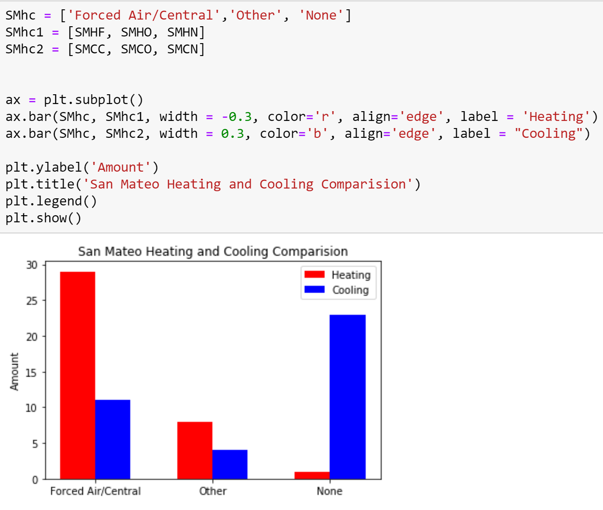
We see that majority of properties in San Mateo have a Forced Air Heating System and no cooling system. This makes sense since being located on the peninsula San Mateo is usually really cold. They have no need for cooling but a lot of need for heating. We do see some places do have cooling systems. These are probably new constructions and most likely higher valued homes.

Slide 11
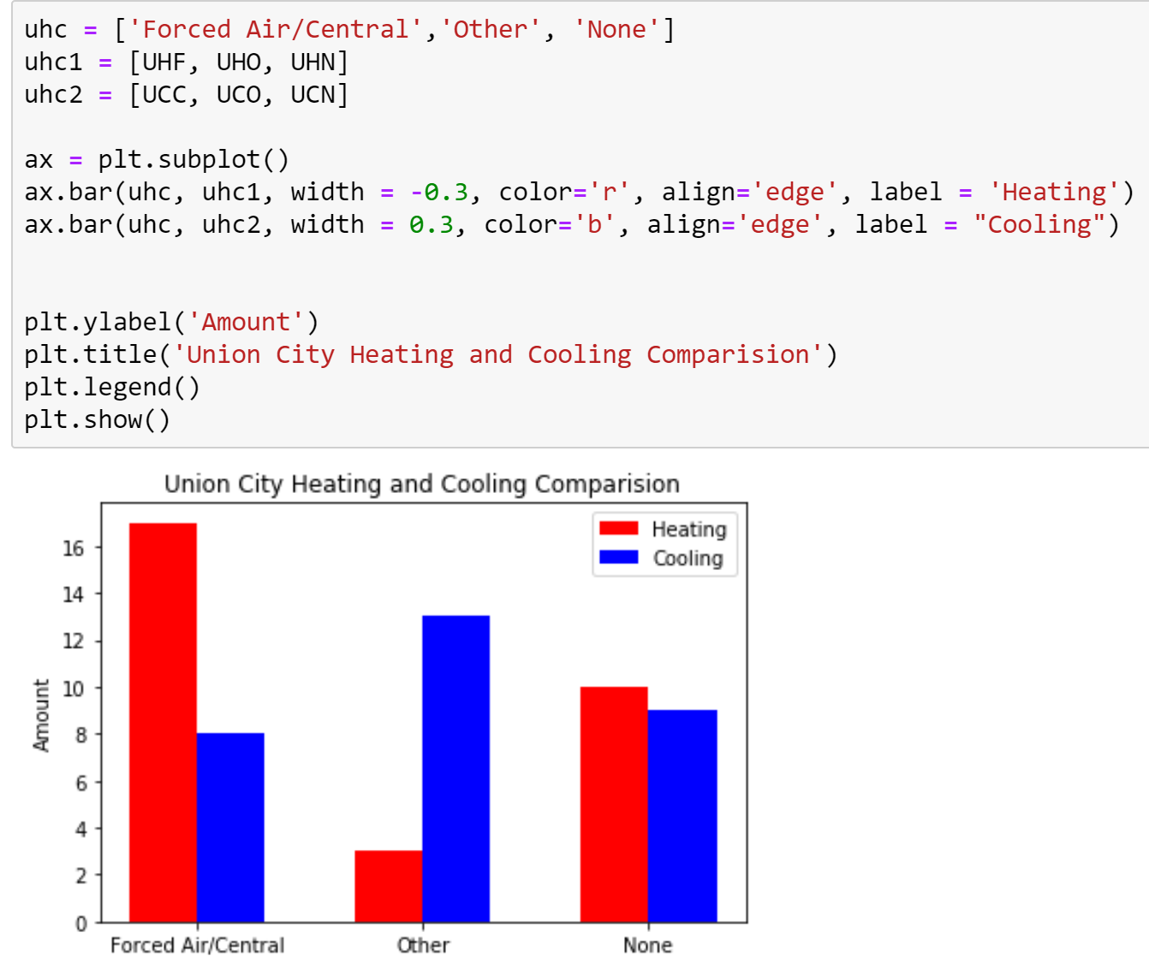
We see with Union City that it is similar to San Mateo with the majority of its properties having a Forced Air Heating System. Unlike San Mateo however, Union City has more properties having some type of cooling system. This is due to the area being closer to the valley and thus hotter during warmer months.

Slide 12
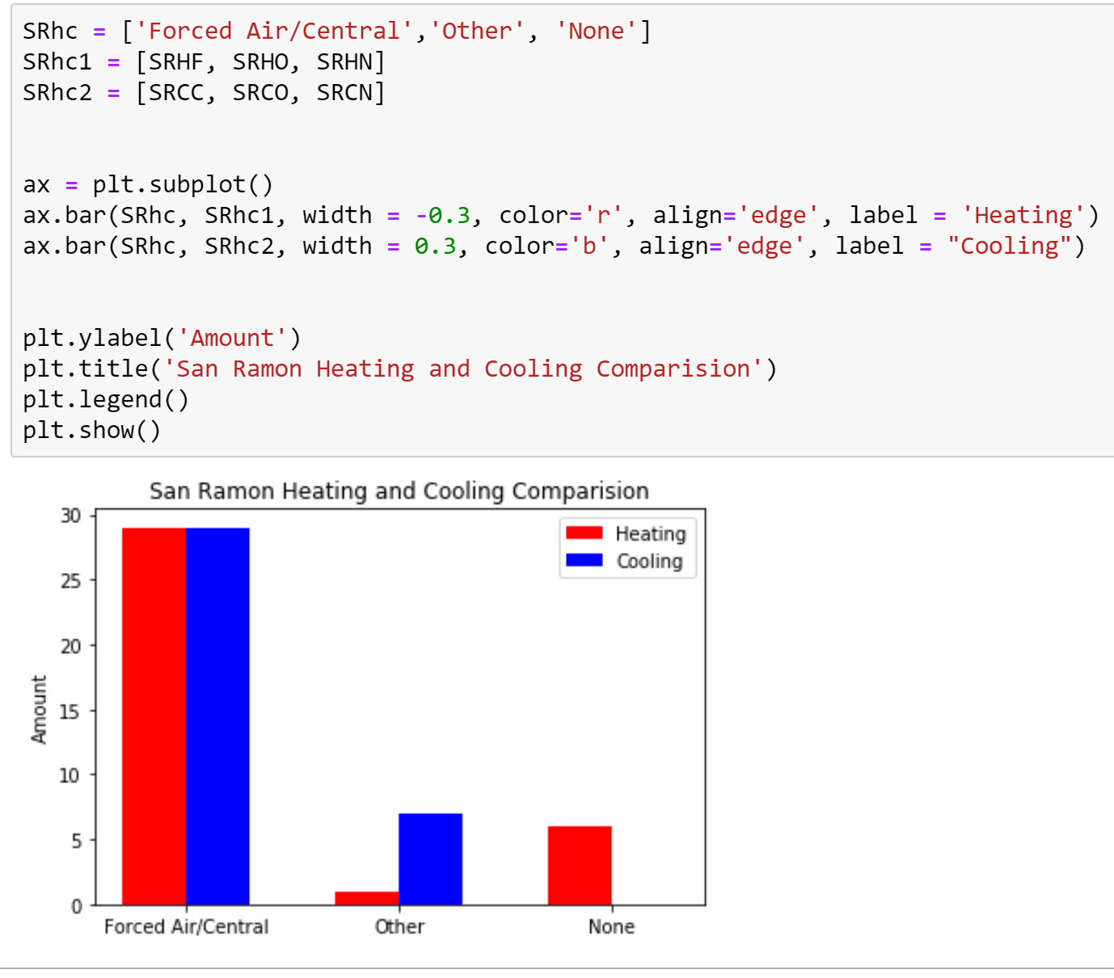
San Ramon boasts the most properties with a Central Cooling System. This makes sense as it is completely in the valley and can be very hot during the warmer months. The valley can also get pretty cold in the winter and so the properties have heating systems as well. As this is completely the suburbs it isn’t surprising to see that the majority of the houses are equipped.

Slide 13
Analysis
Potential Buyers can see what kind of climate they might be buying into with the property. They can also see what kind of temperature regulating amenities they are buying into. Weather is a big factor in a person’s comfort level. This is important for customer satisfaction.

Slide 14
Apt Types in Cities
Method:
Slice the data by city to get apt type data and store them in data frames
Count how many times a specific apt_type appears and save the count in a variable
Plot

Slide 15
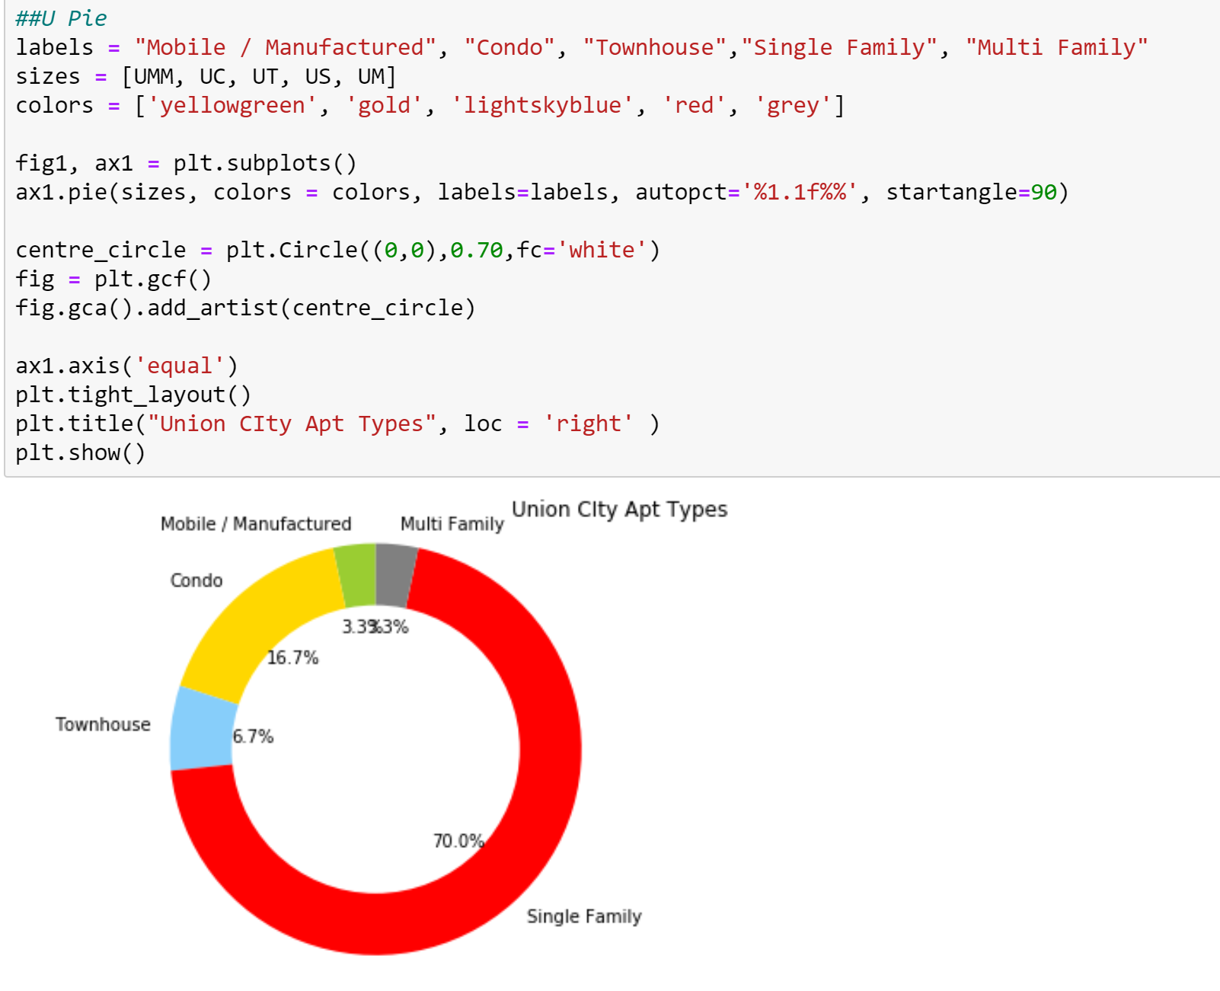
The most favored style of home in Union City is Single Family and Condos are the second. Union City will have people of a lower income bracket and this is seen with the Mobile and Multi family homes. Those with more money may choose to not live here because of this.

Slide 16
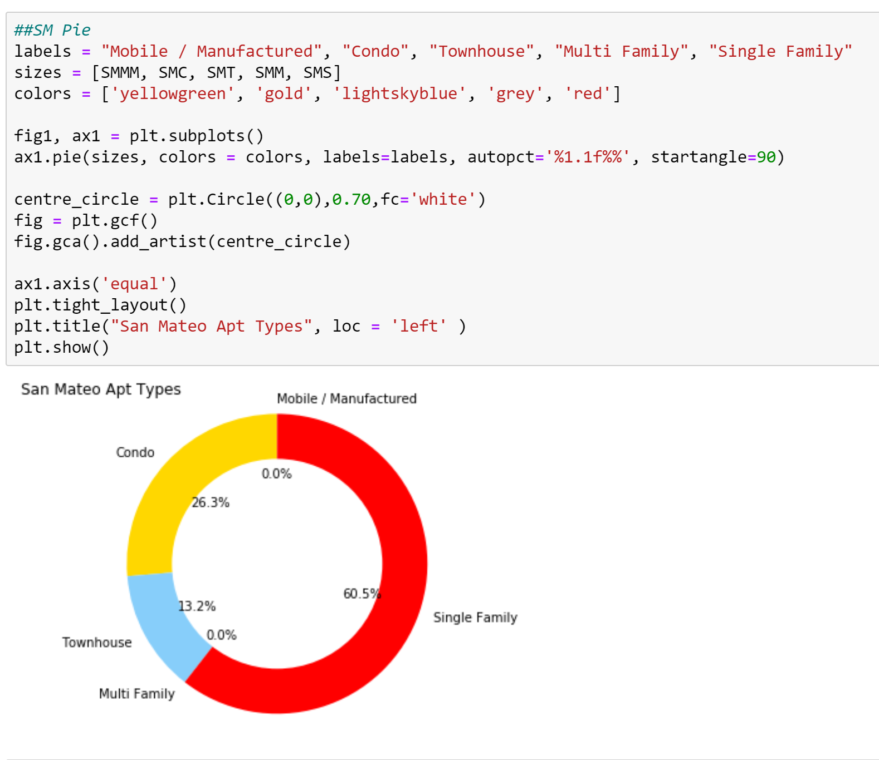
San Mateo only has Single Family, Condo and Townhomes. The most popular type is Single Family and Condo is second. There are no Mobile and Multi Family homes because San Mateo is a richer area. Houses will be separate which is what many will want and higher quality than mobile homes.

Slide 17
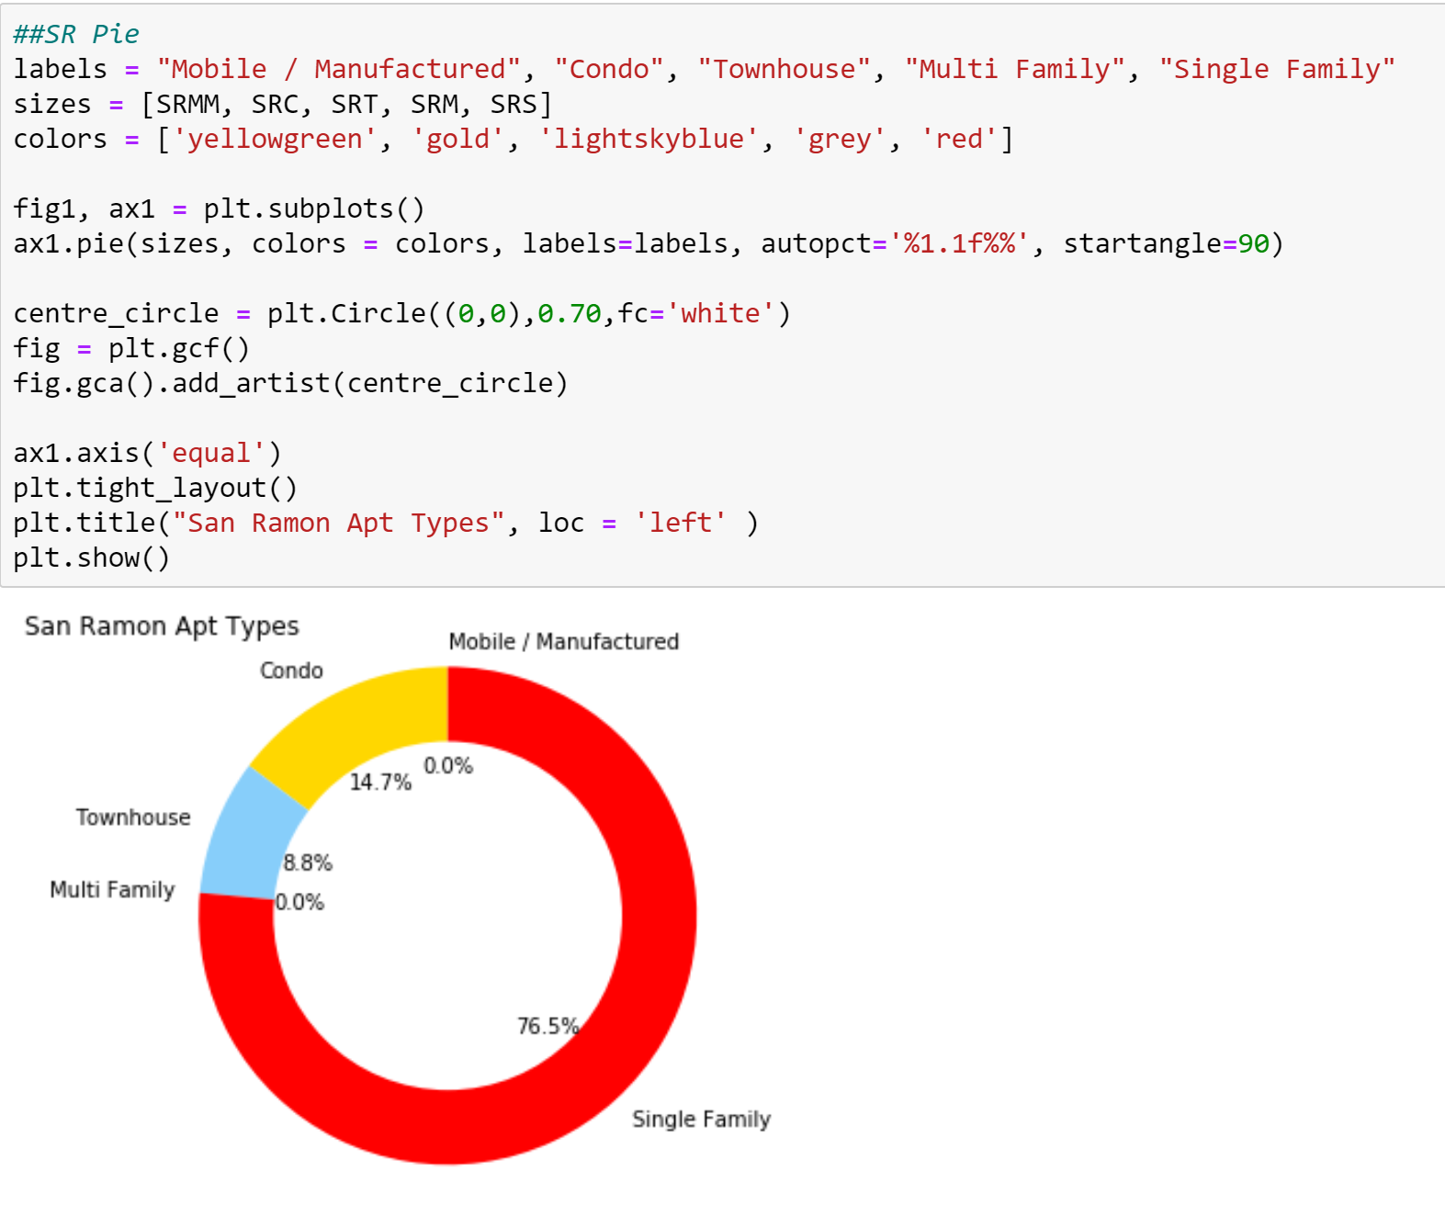
Similar to San Mateo, San Ramon has no Mobile or Multi Family homes. As it is a richer area and the suburbs, people will pay for the privacy and the quality. People looking for, or have similar tastes will look for these types of homes. This can allow buyers to feel more comfortable with their choice.

Slide 18
Analysis
Buyers can see what kind of properties are located in which area. If a Buyer is looking for a particular type of home this can help them. Also this can give an insight into how to area they are trying to live in is. Similar people will try to live in similar places. Buyers can feel more comfortable with their choices.

Slide 19
Conclusion
In conclusion, my analysis can help potential buyers weed out properties and locations that they may be looking at. I was able to take a look at three cities that are in different areas of the Bay Area and see how their properties compare to each other. My analysis can show possibly what kind of climate the properties will be located in, what kind of pricing one may expect and what kinds of homes and possibly people may be living around the Buyer. Overall it was nice to see how the different areas of the Bay differed from each other with what kinds of homes they had available.

Slide 20
Thank you!

